Slide 1
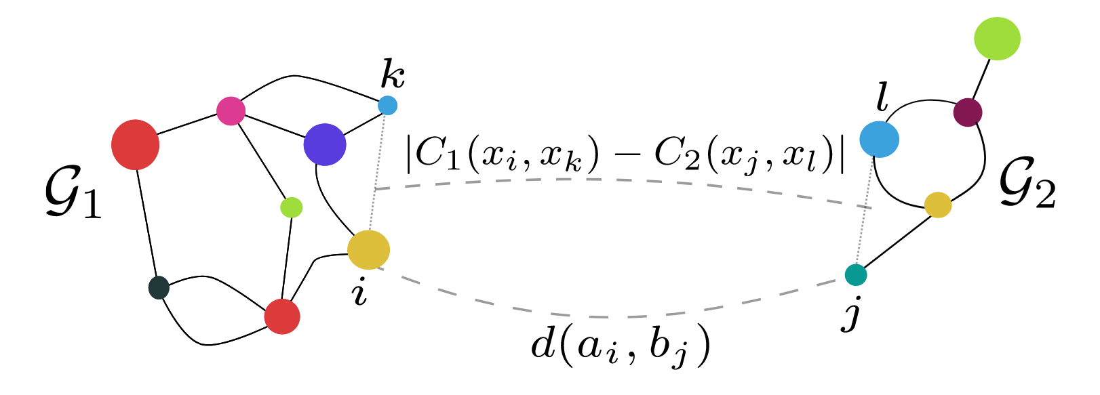
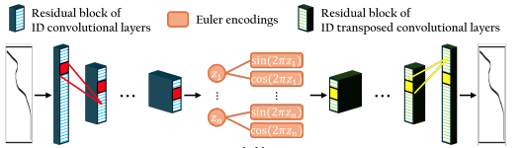
The importance of representation space for photovoltaic discovery
Matthew Walker
Supervisor: Keith Butler
Department of Chemistry
Fused Gromov-Wasserstein (FGW) distances
&
Disentangling Autoencoders (DAEs)

Slide 2
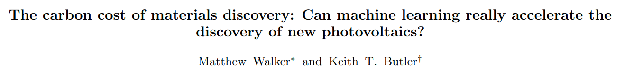
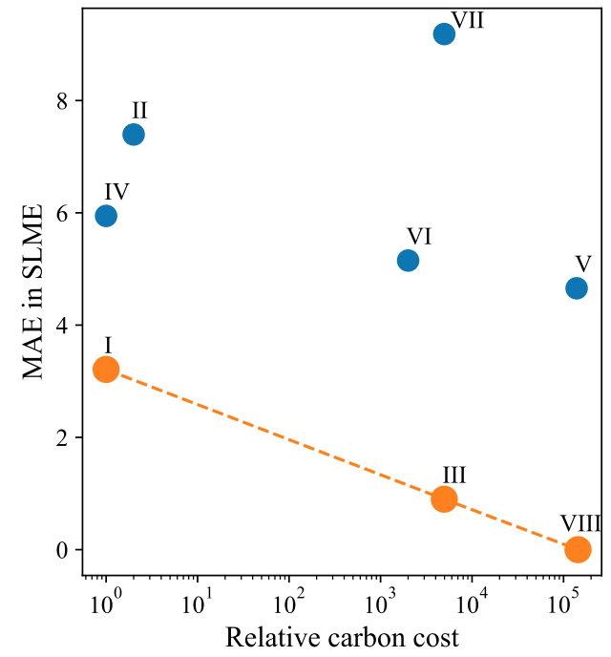
Data-driven photovoltaic discovery
Soon to be in Materials Horizons…
Pareto front of cost vs accuracy for predicting PV efficiency directly vs incorporating learned properties with cheap DFT
Spectrum-predicting approaches are inaccurate
Deep learning remains hard to interpret
https://arxiv.org/abs/2507.13246

Slide 3
Representing absorption spectra
Can we construct lower-dimensional, physically meaningful representations of absorption spectra?

Slide 4
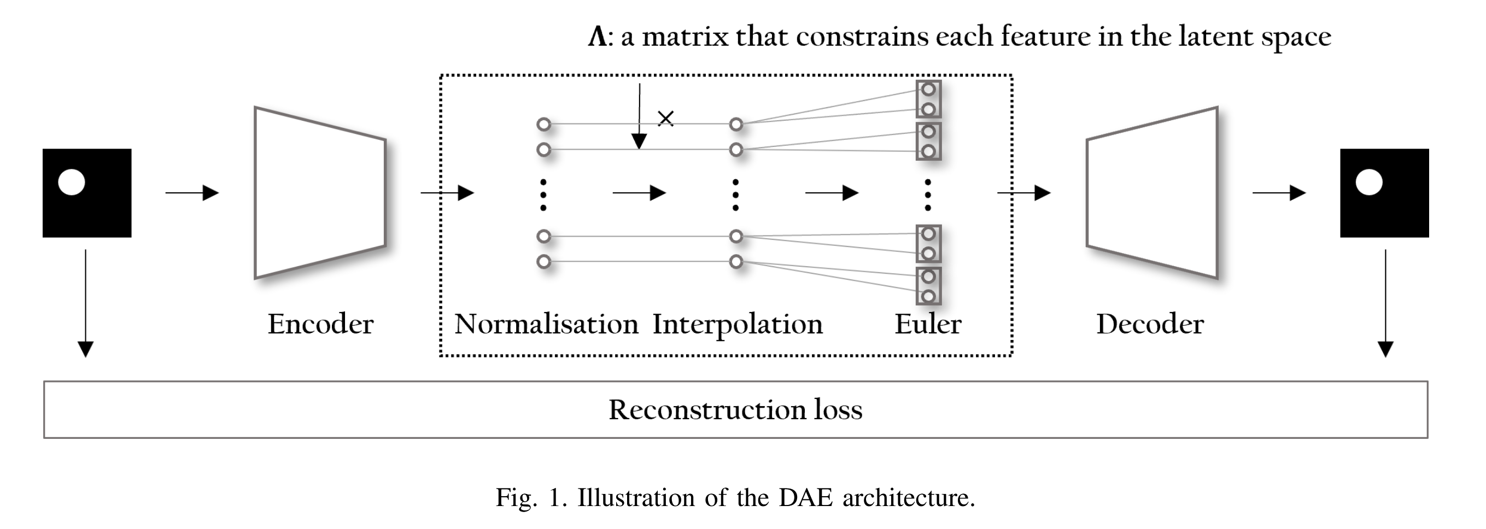
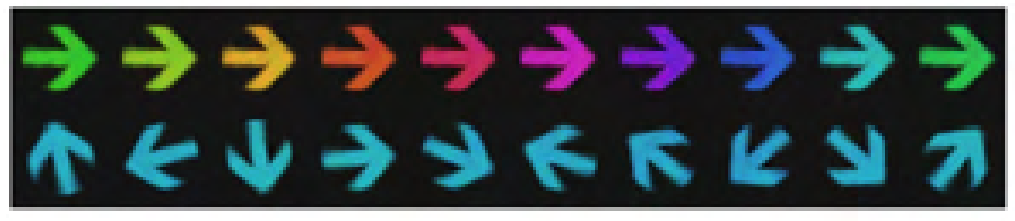
Disentangling latent space
Latent dimension 1
Colour
Latent dimension 2
Direction
Cha, J. & Thiyagalingam, J., Proceedings of the 40th International Conference on Machine Learning. vol. 202, 3913–3948, (PMLR, 2023).

Slide 5
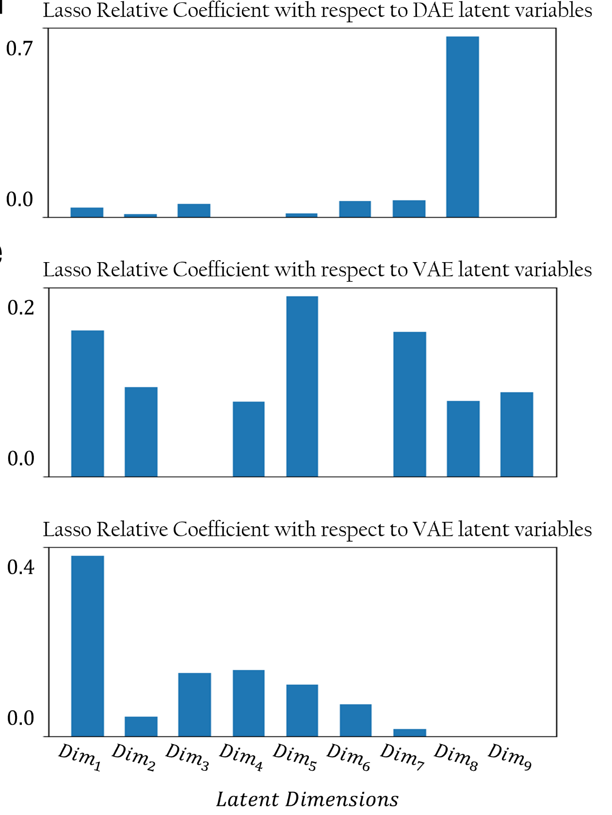
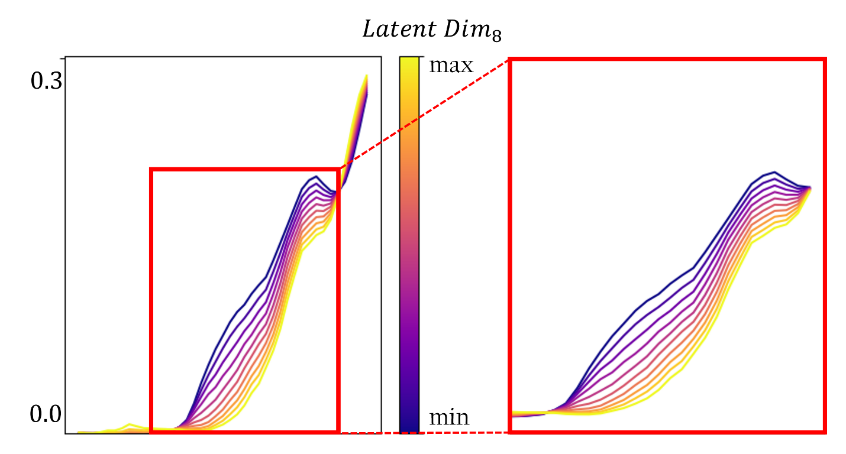
Disentangled representations of absorption spectra
Lasso regression model to predict SLME highlights feature importance
DAE
VAE
Direct gap
PCA
PCA
Indirect gap
One disentangled dimension strongly correlates, seems to be ‘direct-ness’ of band-gap
Cha, J., Lu, T., Walker, M., Butler, K. T., arXiv, 2025, preprint, https://arxiv.org/abs/2507.19602

Slide 6
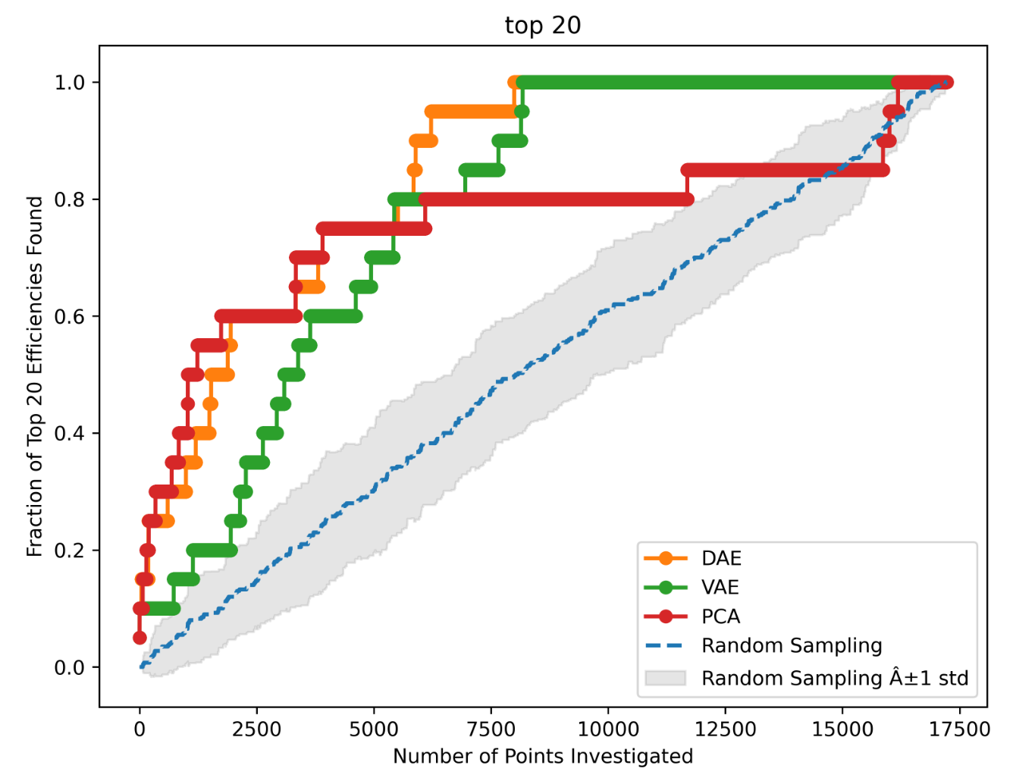
Re-discovering top PVs
Start with absorption spectrum of good PV
Compare to other materials via latent representations
Rank by distance in latent space
DAE re-discovers >60% of top PVs within first 15% of materials and all within 43%

Slide 7
Similarity learning
Instead of comparing absorption spectra, could we discover new functional materials though structural-chemical similarity?

Slide 8
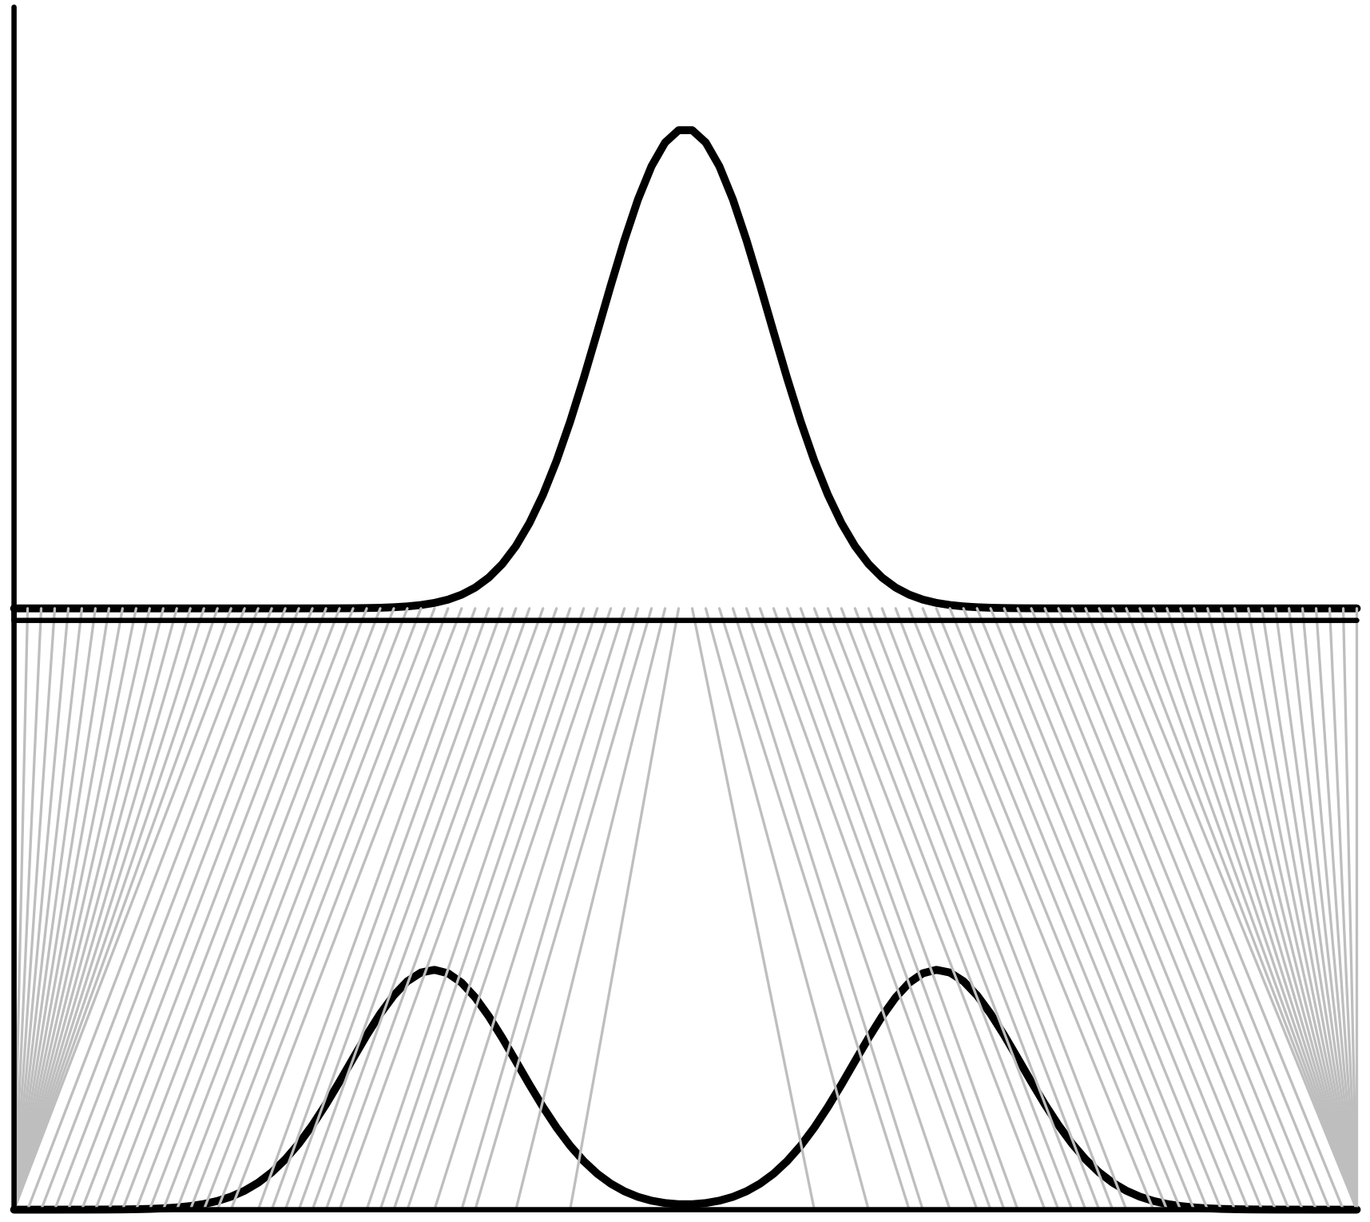
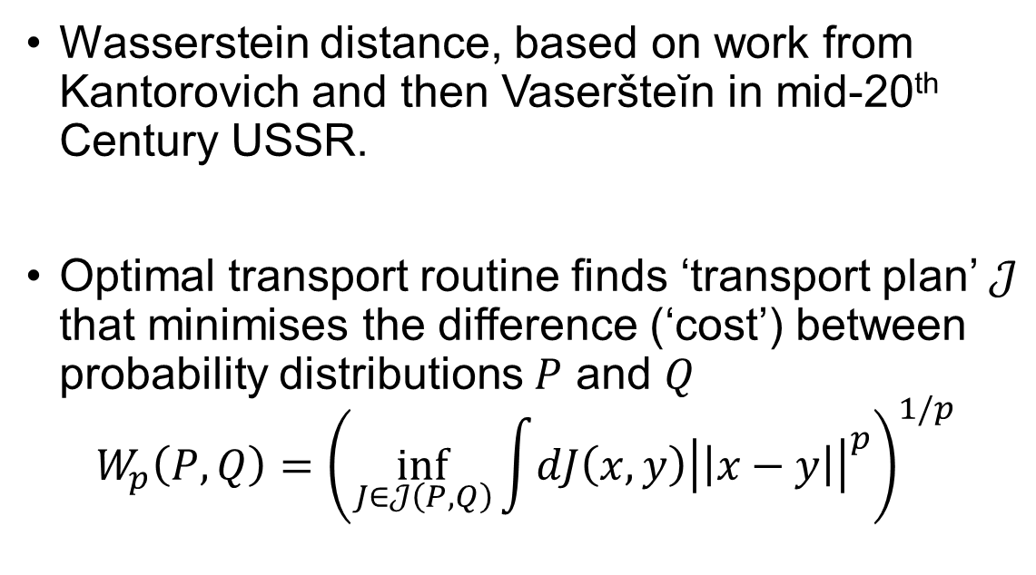
Wasserstein (Kantorovich) distances for comparing distributions
Wasserstein distance, based on work from Kantorovich and then Vaseršteĭn in mid-20th Century USSR.
Optimal transport routine finds ‘transport plan’ $𝒥$ that minimises the difference (‘cost’) between probability distributions $P$ and $Q$
$$W_{p}\left(P,Q\right)={\left(\inf_{J∈𝒥\left(P,Q\right)}{\int{dJ\left(x,y\right){\left|\left|x−y\right|\right|}^{p}}}\right)}^{1/p}$$
P
Q
OT plan to shift from distribution P to Q, from “Optimal Transport and Wasserstein Distance“, https://www.stat.cmu.edu/~larry/=sml/Opt.pdf

Slide 9
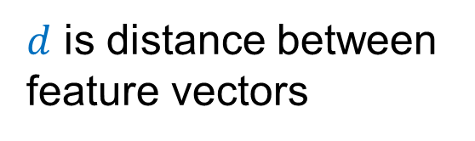
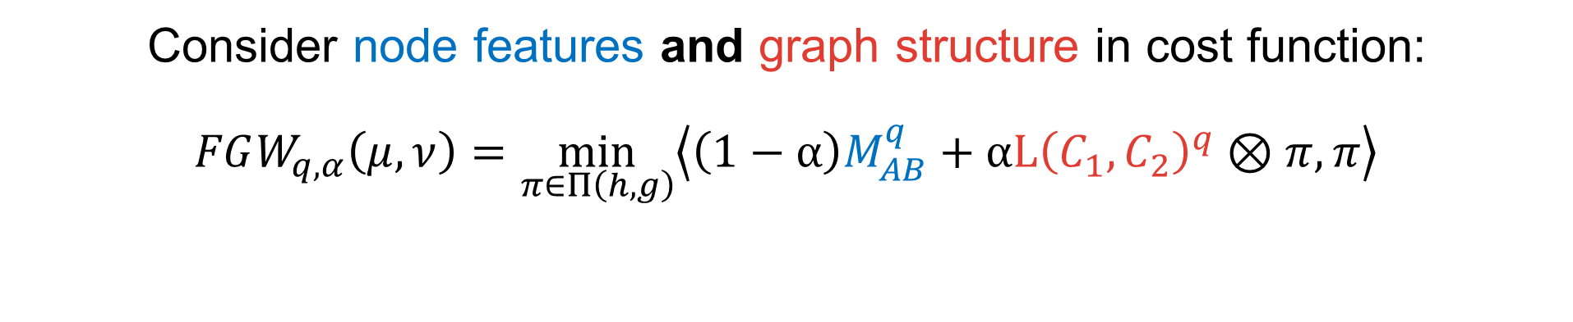
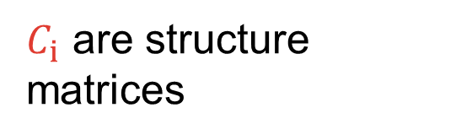
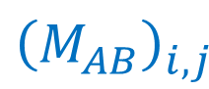
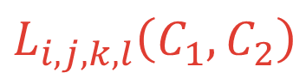
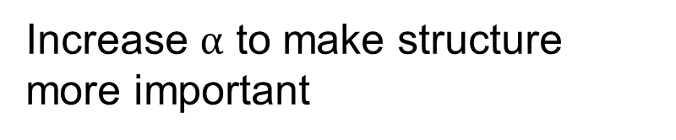
Fused Gromov-Wasserstein distances
Vayer, T., Chapel, L., Flamary, R., Tavenard, R., & Courty, N. (2020) Algorithms, 13(9), 212.
Consider node features and graph structure in cost function: $$FGW_{q,α}\left(μ,ν\right)=\min_{π∈Π\left(h,g\right)}\left\langle \left(1−α\right)M_{AB}^{q}+αL{\left(C_{1},C_{2}\right)}^{q}⊗π,π\right\rangle$$
$$L_{i,j,k,l}\left(C_{1},C_{2}\right)$$
$C_{i}$ are structure matrices
$d$ is distance between feature vectors
$${\left(M_{AB}\right)}_{i,j}$$
Increase $α$ to make structure more important

Slide 10
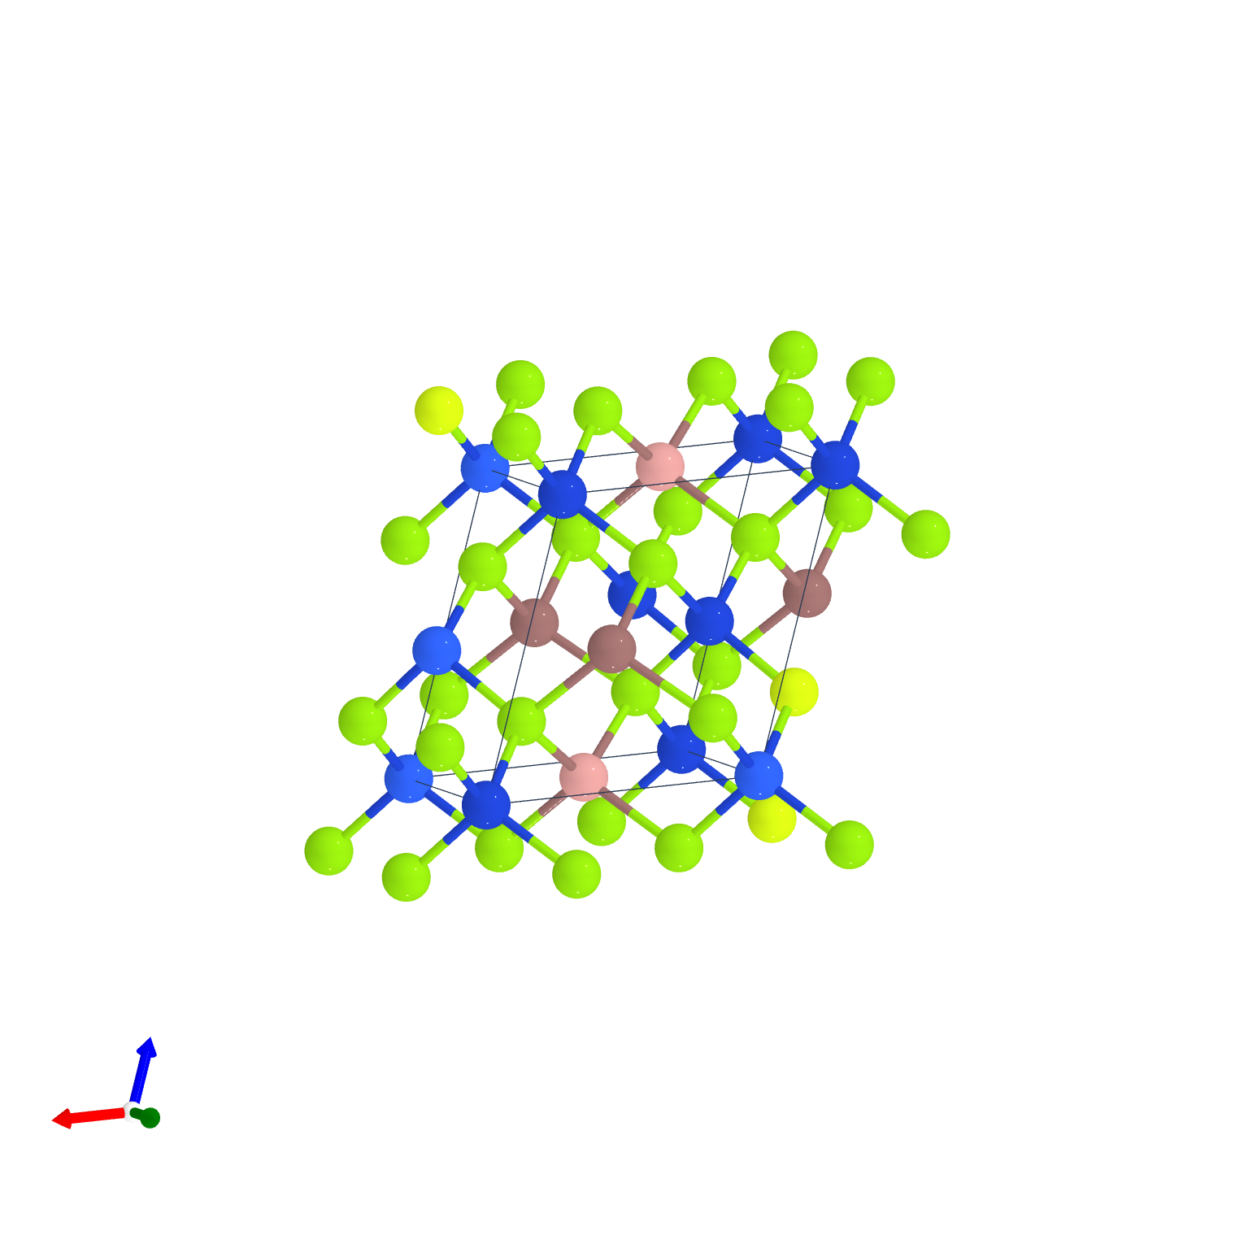
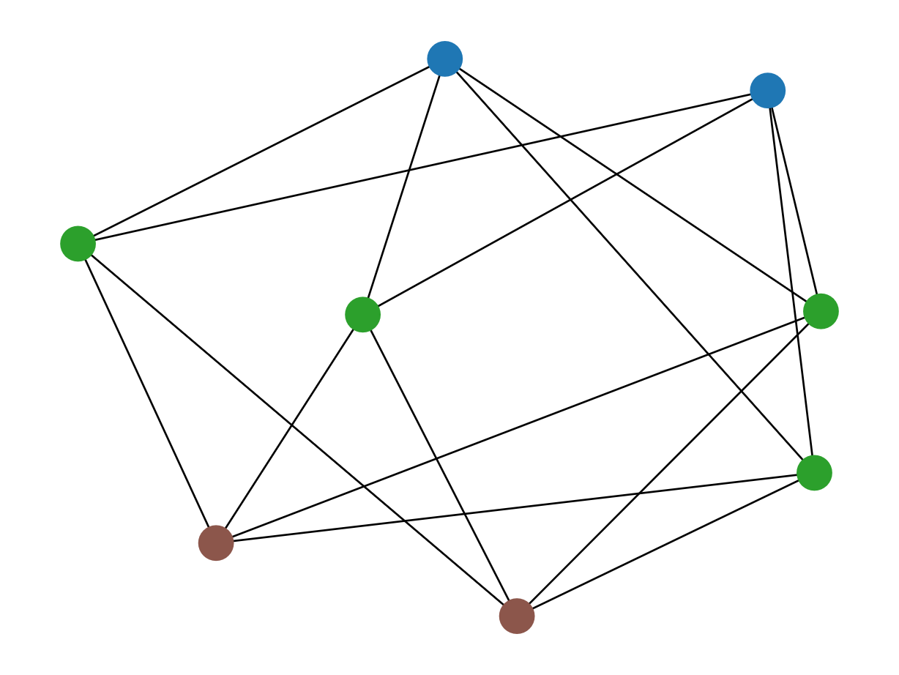
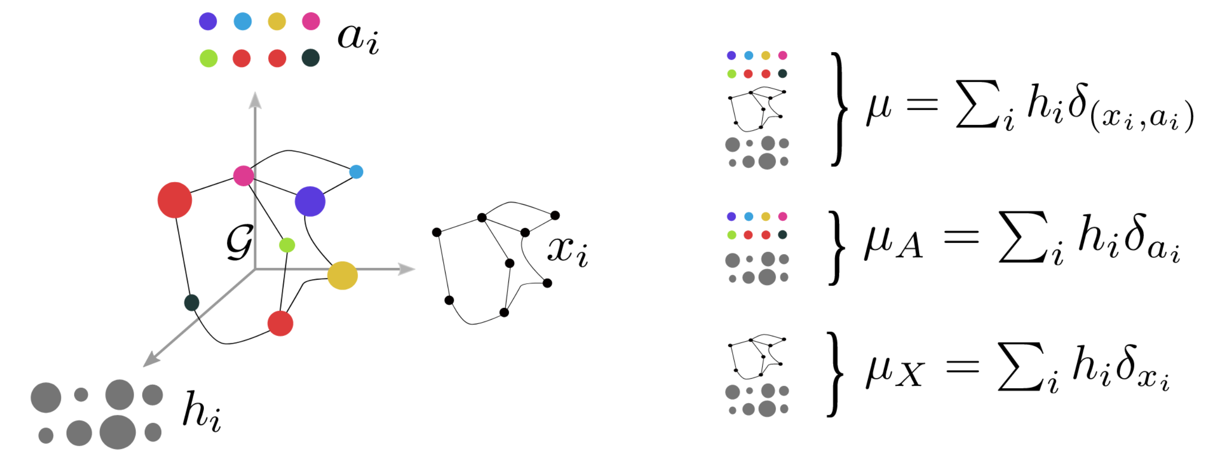
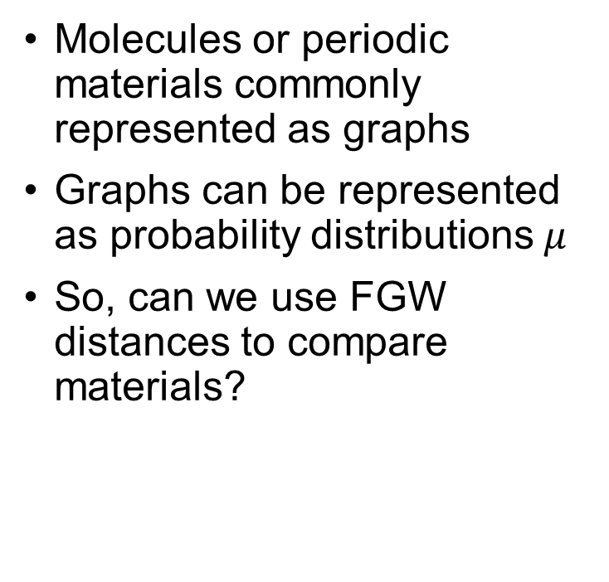
Materials as graphs; Graphs as distributions
Molecules or periodic materials commonly represented as graphs
Graphs can be represented as probability distributions $μ$
So, can we use FGW distances to compare materials?
Feature vectors
Structure
Node importance
Vayer, T., Chapel, L., Flamary, R., Tavenard, R., & Courty, N. (2020) Algorithms, 13(9), 212.

Slide 11
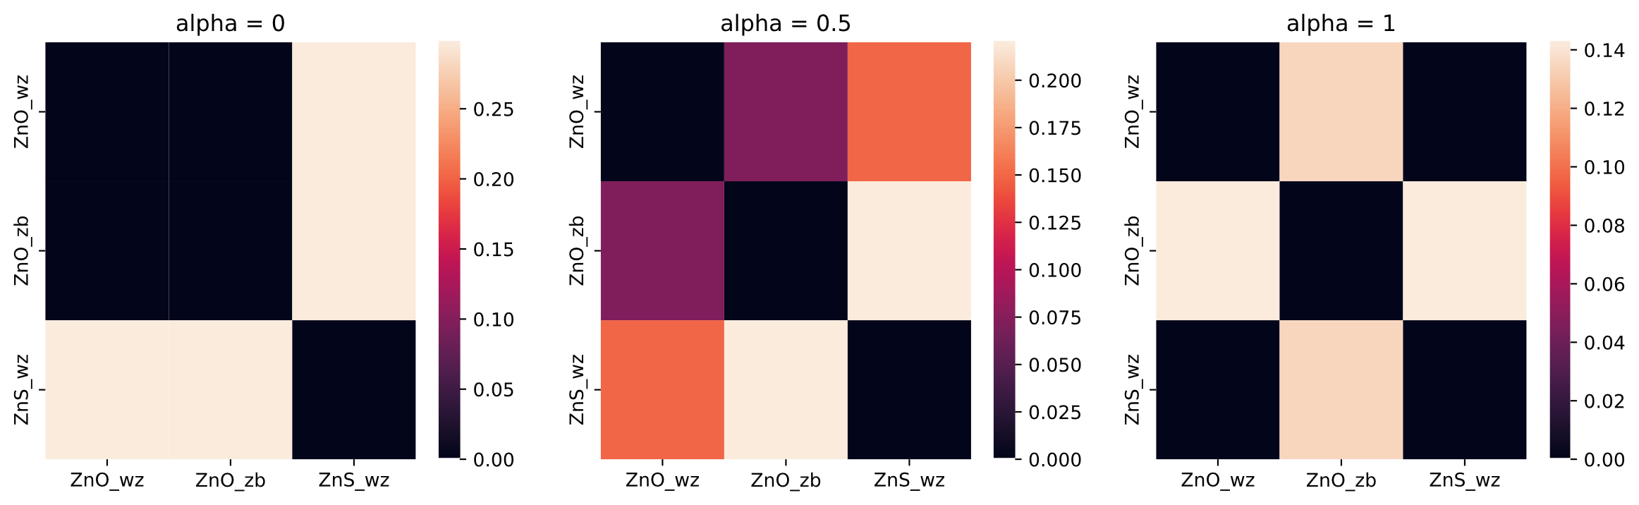
FGW distances to compare polymorphs and isostructures
Increasing α shifts from compositional to structural comparison
ZnO polymorphs same Polymorphs different Polymorphs very different
Wurtzites very different Wurtzites less different Wurtzites same
ZnO wurtzite
ZnO zinc blende
ZnS wurtzite

Slide 12
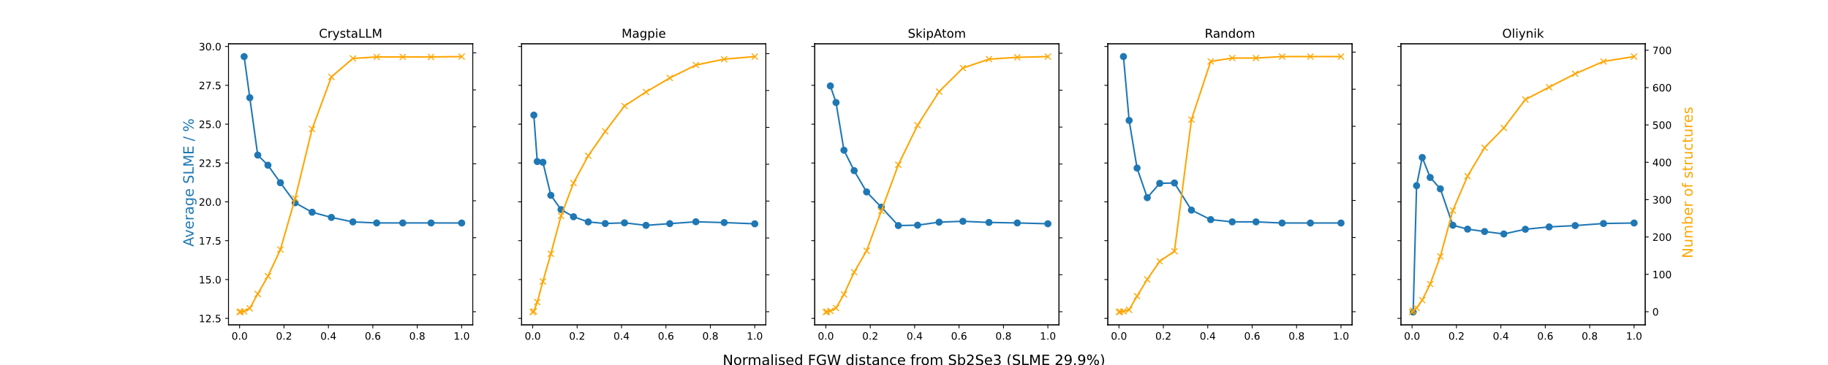
Average SLMEs of similar materials
Starting with ‘seed’ material Sb₂Se₃ with high PV efficiency, sort dataset by FGW distance
In the neighbourhood of similar materials, PV activity is much higher than average

Slide 13
Conclusions
DAEs can construct physically meaningful latent dimensions
Enhance unlabelled data, facilitate prediction of spectra
FGW distances quantify structural and compositional differences between structures, with parameter to balance them
Transport matrix provides some insight into material similarity
Makes similarity-based materials discovery more quantitative

Slide 14
Ongoing work
DAE
Learn latent dimensions + decode predictions for more accurate spectrum prediction
Construct meaningful representations of other spectra
FGW distances
Diversity of CrystaLLM-generated materials
Other properties: bulk moduli, polarisation
Structure matcher – distinguish between polymorphs
Fused Gromov-Wasserstein distances: quantifying compositional and structural similarity for materials discovery. M. Walker, K. T. Butler, Z. Zhou, J. Islam, C. Bone, In prep

Slide 15
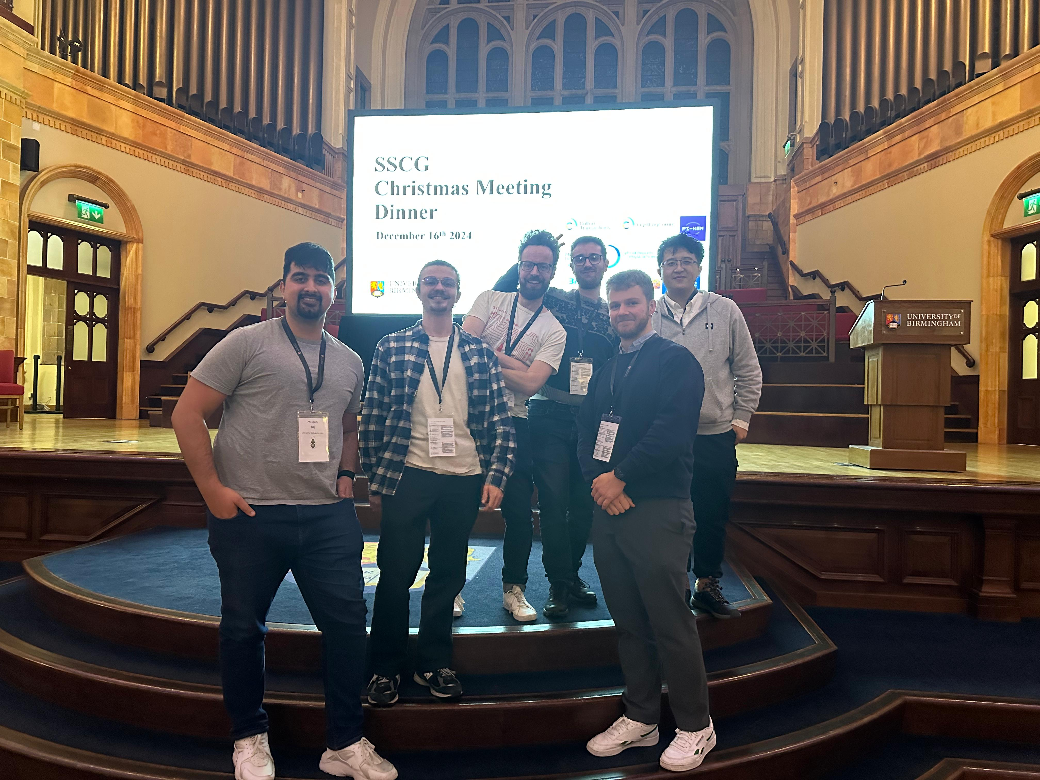
Acknowledgements
Keith Butler and the MDIG group
Jaehoon Cha & Tingyao Lu (DAE)
Junayd Islam & Harry Zhou (FGW)
MMM Hub Young and Myriad (HPC)
Thank you for listening!

